Slide 1
K-Means Clustering with Open-MP
Parallel Computing
(Mid-Term Assignment)
Davide Del Bimbo
davide.delbimbo@edu.unifi.it
09/11/2023

Slide 2
K-Means Clustering with OpenMP
Introduction
Introduction
K-Means is a clustering algorithm.
Unsupervised learning technique.
Identify patterns in data and divide it into groups or clusters.
Assign each data point to one cluster:
Data within the same cluster are similar.
Data within different clusters are dissimilar.

Slide 3

K-Means Clustering with OpenMP
Introduction
Dataset $𝒳=\{x_{1},…,x_{N}\}$.
Clusters $𝒞=\left\{𝒞_{1},…,𝒞_{K}\right\}$:
Disjointed: $𝒞_{i}∩𝒞_{j}=∅ ∀i≠j$.
Centroid: $μ_{k}=\frac{1}{\left|𝒞_{k}\right|}\sum_{xε𝒞_{k}}{x}.$
Goal: minimize the within-cluster sum-of-square criterion, called inertia.
$$\sum_{i=0}^{N}{\min_{μ_{k}ε𝒞}\left\|x_{i}−μ_{k}\right\|}$$

Slide 4
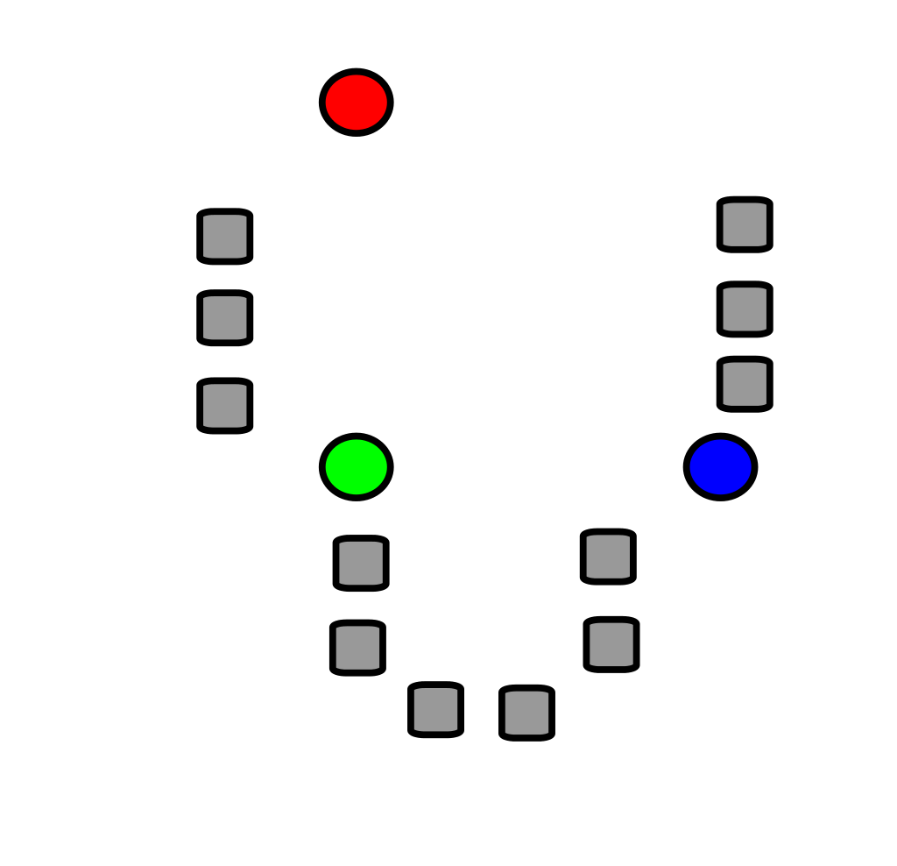
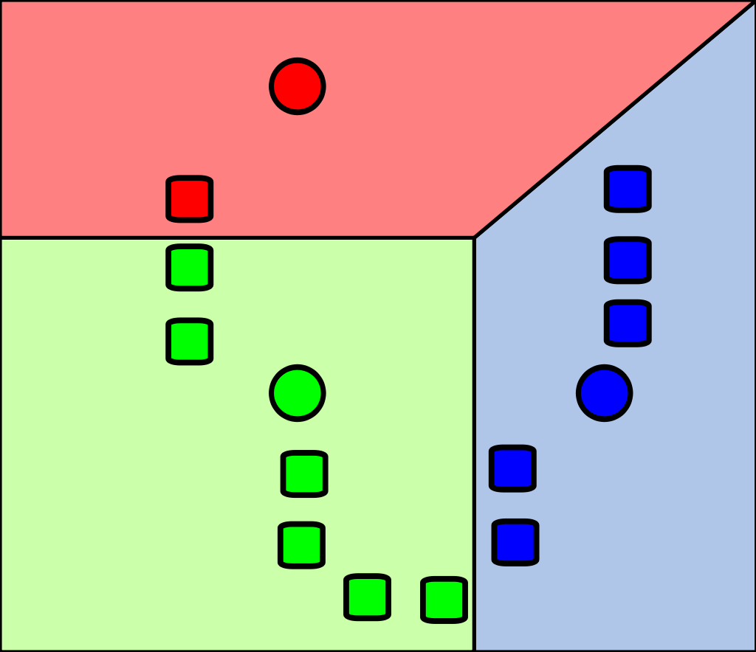
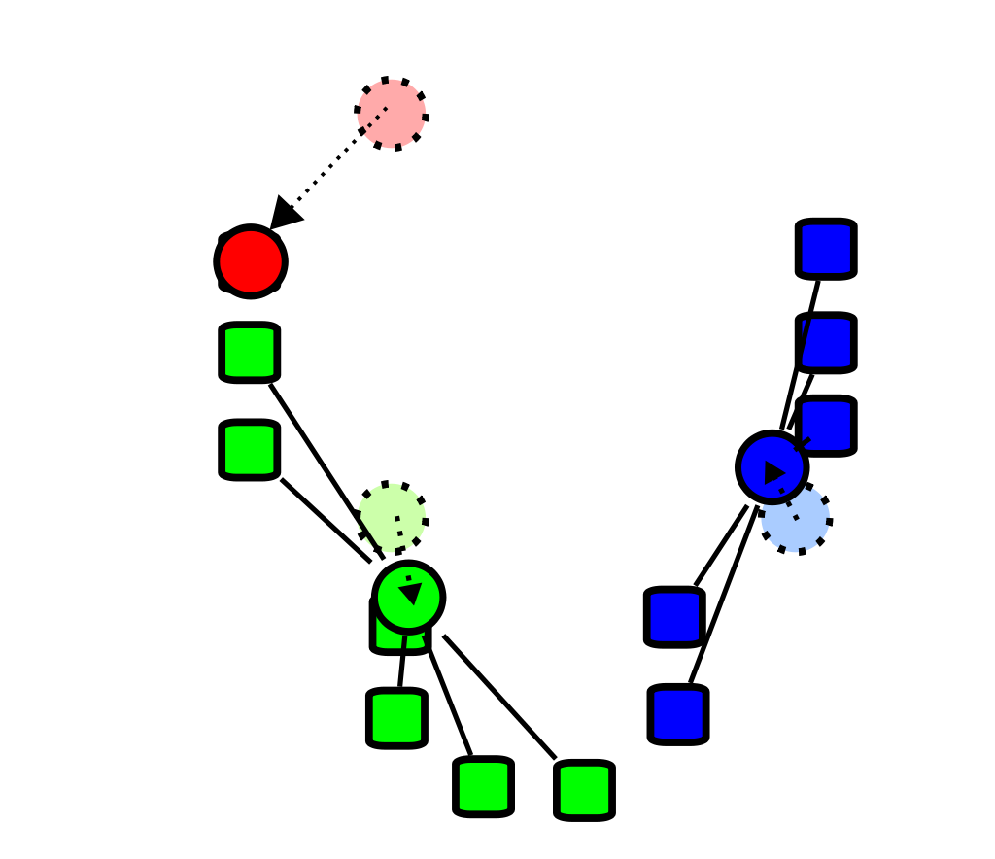
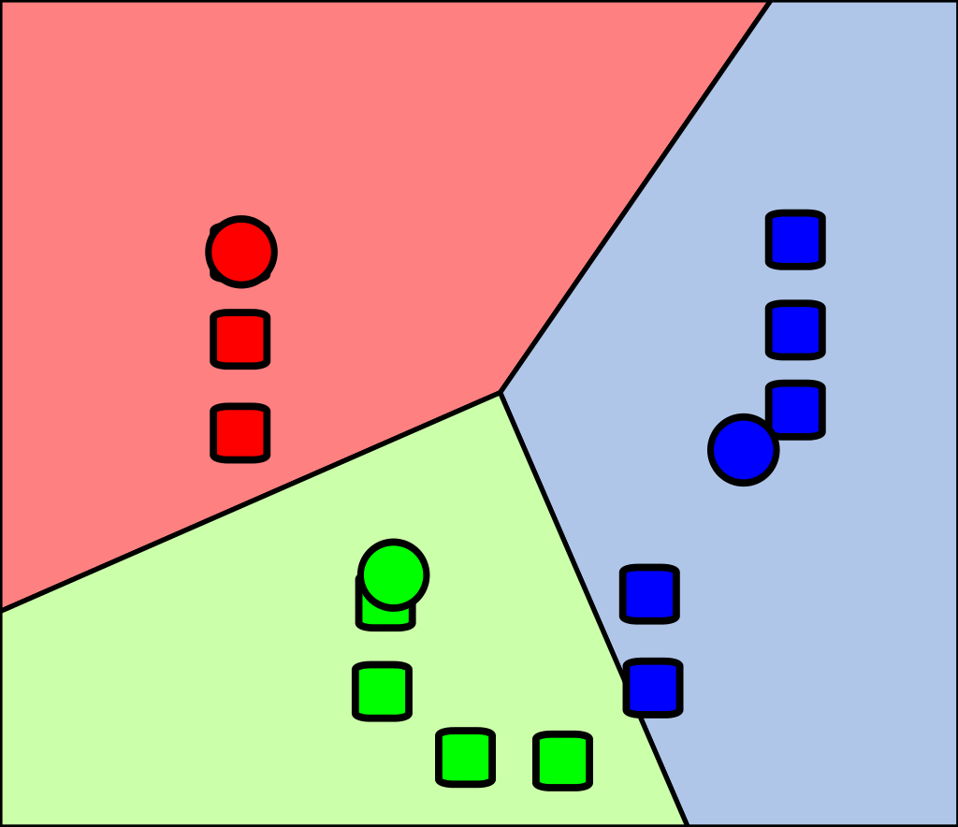

K-Means Clustering with OpenMP
Algorithm
Algorithm
Initialization: given dataset $𝒳=\{x_{1},…,x_{N}\}$ of $N$ multidimensional samples, choose $K$ random initial cluster centroids from the dataset.
Assignments: assign each data point to the centroid of the nearest cluster based on a distance metric (Euclidean distance).
Updates: update cluster centroids by calculating the mean of all data points assigned to each cluster.
Repeat: repeat steps 2 and 3 until convergence is achieved.

Slide 5
K-Means Clustering with OpenMP
Introduction
Convergence criteria:
No shifts in centroids (EPSILON = 1e-6).
No change in the allocation of points.
Reaching the minimum sum of distances.
Maximum limit of iterations (MAX_ITERATIONS = 500).

Slide 6
K-Means Clustering with OpenMP
Introduction
Convergence criteria:
No shifts in centroids (EPSILON = 1e-6).
No change in the allocation of points.
Reaching the minimum sum of distances.
Maximum limit of iterations (MAX_ITERATIONS = 500).

Slide 7
K-Means Clustering with OpenMP
Introduction
Convergence criteria:
No shifts in centroids (EPSILON = 1e-6).
No change in the allocation of points.
Reaching the minimum sum of distances.
Maximum limit of iterations (MAX_ITERATIONS = 500).

Slide 8
K-Means Clustering with OpenMP
Sequential implementation
Sequential implementation
Point: class representing a multidimensional data point.
coordinates: coordinates of data point (vector<double>).
pointId: unique identifier of data point (int).
clusterId: identifier of assigned cluster (int). Initialize to default value -1.
Centroid: class representing a multidimensional centroid of a cluster.
coordinates: coorindates of centroid (vector<double>).
clusterId: unique identifier of assigned cluster (int).

Slide 9
K-Means Clustering with OpenMP
Sequential implementation
// Point in multidimensional space.
struct Point {
vector<double> coordinates; // Vector of coordinates.
int pointId; // Identifier of the point.
int clusterId; // Identifier of the cluster to which the point belongs.
Point(const vector<double>& coordinates, const int pointId,
const int clusterId);
};
// Centroid in multidimensional space.
struct Centroid {
vector<double> coordinates; // Vector of coordinates.
int clusterId; // Identifier of the cluster.
Centroid(const vector<double>& coordinates, const int clusterId);
};

Slide 10
K-Means Clustering with OpenMP
Sequential implementation
KMeans: class representing K-Means algorithm.
Instantiates N data points randomly or from an input dataset.
Instantiates K clusters from distinct random data points.
Runs KMeansIteration method until the convergence criterion is met.
Provides a results plotting and a GIF animation of the execution.
Saves the execution time of results to a file.
KMeansIteration: method representing a single iteration of K-Means algorithm.

Slide 11
K-Means Clustering with OpenMP
Sequential implementation
// Variables for the mean of the points in each cluster.
vector<std::vector<double>> clustersSum(K, vector<double>(dimensions, 0));
vector<int> clustersSize(K, 0);
// Convergence flag. Assume convergence at the beginning.
bool converged = true;
// Assign each point to the closest centroid.
for(int i = 0; i < N; i++) {
double minDist = DBL_MAX;
int minClusterId = -1;
for(int j = 0; j < K; j++) {
double dist = distance(points[i], centroids[j]); if(dist < minDist) {
minDist = dist;
minClusterId = j;
}
}
// Assign the point to the closest cluster.
points[i].clusterId = minClusterId;
for(int dim = 0; dim < dimensions; dim++) {
clustersSum[minClusterId][dim] += points[i].coordinates[dim];
}
clustersSize[minClusterId]++;
}

Slide 12
K-Means Clustering with OpenMP
Sequential implementation
// Variables for the mean of the points in each cluster.
vector<std::vector<double>> clustersSum(K, vector<double>(dimensions, 0));
vector<int> clustersSize(K, 0);
// Convergence flag. Assume convergence at the beginning.
bool converged = true;
// Assign each point to the closest centroid.
for(int i = 0; i < N; i++) {
double minDist = DBL_MAX;
int minClusterId = -1;
for(int j = 0; j < K; j++) {
double dist = distance(points[i], centroids[j]); if(dist < minDist) {
minDist = dist;
minClusterId = j;
}
}
// Assign the point to the closest cluster.
points[i].clusterId = minClusterId;
for(int dim = 0; dim < dimensions; dim++) {
clustersSum[minClusterId][dim] += points[i].coordinates[dim];
}
clustersSize[minClusterId]++;
}

Slide 13
K-Means Clustering with OpenMP
Sequential implementation
// Variables for the mean of the points in each cluster.
vector<std::vector<double>> clustersSum(K, vector<double>(dimensions, 0));
vector<int> clustersSize(K, 0);
// Convergence flag. Assume convergence at the beginning.
bool converged = true;
// Assign each point to the closest centroid.
for(int i = 0; i < N; i++) {
double minDist = DBL_MAX;
int minClusterId = -1;
for(int j = 0; j < K; j++) {
double dist = distance(points[i], centroids[j]); if(dist < minDist) {
minDist = dist;
minClusterId = j;
}
}
// Assign the point to the closest cluster.
points[i].clusterId = minClusterId;
for(int dim = 0; dim < dimensions; dim++) {
clustersSum[minClusterId][dim] += points[i].coordinates[dim];
}
clustersSize[minClusterId]++;
}
const double distance(const Point &p, const Centroid &c) {
double sum = 0;
for (int dim = 0; dim < dimensions; dim++) {
sum += (c.coordinates[dim] - p.coordinates[dim]) * (c.coordinates[dim] - p.coordinates[dim]);
}
return sqrt(sum);
}

Slide 14
K-Means Clustering with OpenMP
Sequential implementation
// Update the centroids.
for(int j = 0; j < K; j++){
// Temporary variable for the previous centroid coordinate.
double tmpCoordinate = 0;
// Update the centroid of the cluster.
for(int dim = 0; dim < dimensions; dim++) {
// Save the previous centroid coordinate.
tmpCoordinate = centroids[j].coordinates[dim];
centroids[j].coordinates[dim] = clustersSum[j][dim] / clustersSize[j];
// Check for convergence (i.e. if the centroid change position in a dimension).
if (fabs(tmpCoordinate - centroids[j].coordinates[dim]) > EPSILON) {
converged = false;
}
}
}

Slide 15

K-Means Clustering with OpenMP
Parallel implementation
Parallel implementation
Uses the SoA (Structure of Arrays) architecture.
Uses linearized vectors to represent multidimensional matrices.
Uses OpenMP pragmas to enable multithreading and parallelized code:
Parallelization of the first loop, as it requires high cost for large datasets ($O(N×K×D)$).
No parallelization of the second loop, since it has a small cost for tipical values of $K$ ($O(K×D)$). It may result in overhead costs.
Vectorization of distance calculation to enable SIMD processing.

Slide 16
K-Means Clustering with OpenMP
Sequential implementation
// Points in multidimensional space using SoA architecture.
struct Points {
const int size; // Number of points.
double* coordinates; // Array of coordinates of all dimensions.
int* pointsIds; // Array of points identifiers.
int* clustersIds; // Array of clusters identifiers to which the points belong.
Points(const int size, double* coordinates, int* pointsIds,
int* clustersIds);
~Points();
};
// Centroids in multidimensional space using SoA architecture.
struct Centroids {
const int size; // number of clusters. double* coordinates; // Array for coordinates of all dimensions.
int* clustersIds; // Array for clusters identifiers.
Centroids(const int size, double* coordinates, int* clustersIds);
~Centroids();
};

Slide 17
K-Means Clustering with OpenMP
Sequential implementation
// Variables for the mean of the points in each cluster.
double clustersSum[K * dimensions] = {0}; // Sum of coordinates of points in each cluster.
int clustersSize[K] = {0}; // Number of points in each cluster.
// Convergence flag. Assume convergence at the beginning.
bool converged = true;
// Assign each point to the closest centroid.
#pragma omp parallel for schedule(static) default(none) \
shared(points, centroids, clustersSum, clustersSize, converged)
for(int i = 0; i < N; i++) {
double minDist = DBL_MAX;
int minClusterId = -1;
for(int j = 0; j < K; j++) {
double dist = distance(i, j); if(dist < minDist) {
minDist = dist;
minClusterId = j;
}
}
// Update the identifier of the cluster.
points.clustersIds[i] = minClusterId;
for(int dim = 0; dim < dimensions; dim++) {
#pragma omp atomic
clustersSum[minClusterId + K * dim] += points.coordinates[i + N * dim];
}
#pragma omp atomic
clustersSize[minClusterId]++;
}

Slide 18
K-Means Clustering with OpenMP
Sequential implementation
// Variables for the mean of the points in each cluster.
double clustersSum[K * dimensions] = {0}; // Sum of coordinates of points in each cluster.
int clustersSize[K] = {0}; // Number of points in each cluster.
// Convergence flag. Assume convergence at the beginning.
bool converged = true;
// Assign each point to the closest centroid.
#pragma omp parallel for schedule(static) default(none) \
shared(points, centroids, clustersSum, clustersSize, converged)
for(int i = 0; i < N; i++) {
double minDist = DBL_MAX;
int minClusterId = -1;
for(int j = 0; j < K; j++) {
double dist = distance(i, j); if(dist < minDist) {
minDist = dist;
minClusterId = j;
}
}
// Update the identifier of the cluster.
points.clustersIds[i] = minClusterId;
for(int dim = 0; dim < dimensions; dim++) {
#pragma omp atomic
clustersSum[minClusterId + K * dim] += points.coordinates[i + N * dim];
}
#pragma omp atomic
clustersSize[minClusterId]++;
}

Slide 19
K-Means Clustering with OpenMP
Sequential implementation
// Variables for the mean of the points in each cluster.
double clustersSum[K * dimensions] = {0}; // Sum of coordinates of points in each cluster.
int clustersSize[K] = {0}; // Number of points in each cluster.
// Convergence flag. Assume convergence at the beginning.
bool converged = true;
// Assign each point to the closest centroid.
#pragma omp parallel for schedule(static) default(none) \
shared(points, centroids, clustersSum, clustersSize, converged)
for(int i = 0; i < N; i++) {
double minDist = DBL_MAX;
int minClusterId = -1;
for(int j = 0; j < K; j++) {
double dist = distance(i, j); if(dist < minDist) {
minDist = dist;
minClusterId = j;
}
}
// Update the identifier of the cluster.
points.clustersIds[i] = minClusterId;
for(int dim = 0; dim < dimensions; dim++) {
#pragma omp atomic
clustersSum[minClusterId + K * dim] += points.coordinates[i + N * dim];
}
#pragma omp atomic
clustersSize[minClusterId]++;
}
const double distance(const int pointId, const int centroidId) {
double sum = 0;
#pragma omp simd reduction(+:sum)
for (int dim = 0; dim < dimensions; dim++) {
sum += (centroids.coordinates[centroidId + K*dim] - points.coordinates[pointId + N*dim]) *
(centroids.coordinates[centroidId + K*dim] - points.coordinates[pointId + N*dim]);
}
return sqrt(sum);
}

Slide 20
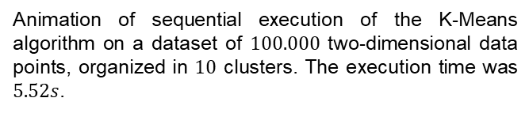
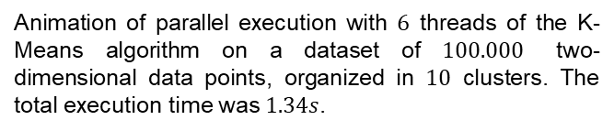
K-Means Clustering with OpenMP
Correctness
Correctness
Animation of sequential execution of the K-Means algorithm on a dataset of $100.000$ two-dimensional data points, organized in $10$ clusters. The execution time was $5.52s$.
Animation of parallel execution with $6$ threads of the K-Means algorithm on a dataset of $100.000$ two-dimensional data points, organized in $10$ clusters. The total execution time was $1.34s$.

Slide 21

K-Means Clustering with OpenMP
Performance
Performance
Analysis of speedup as the number of data points, number of clusters and data point dimensions change:
Dataset of $1.000$, $10.000$, $100.000$, $1.000.000$, $10.000.000$ two-dimensional data points, organized in $10$ clusters.
Dataset of $10.000$two-dimensional data points, organized in $2$, $5$, $10$, $50$, $100$ clusters.
Dataset of $10.000$data points with $2$, $3$, $5$, $10$, $20$ dimensions, organized in $10$ clusters.
Comparison of AoS and SoA architectures.

Slide 22
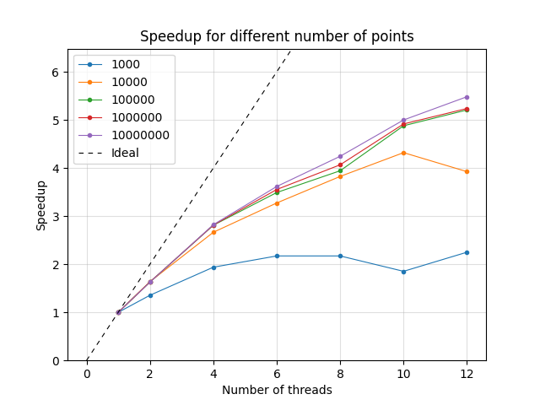
K-Means Clustering with OpenMP
Performance
Speed as the number of points changes:
 | 2 Threads | 4 Threads | 6 Threads | 8 Threads | 10 Threads | 12 Threads
1.000 | 1,35 | 1,94 | 2,17 | 2,17 | 1,85 | 2,25
10.000 | 1,64 | 2,65 | 3,27 | 3,83 | 4,32 | 3,92
100.000 | 1,63 | 2,81 | 3,49 | 3,94 | 4,88 | 5,21
1.000.000 | 1,63 | 2,81 | 3,55 | 4,07 | 4,92 | 5,24
10.000.000 | 1,63 | 2,82 | 3,62 | 4,24 | 5,00 | 5,48

Slide 23
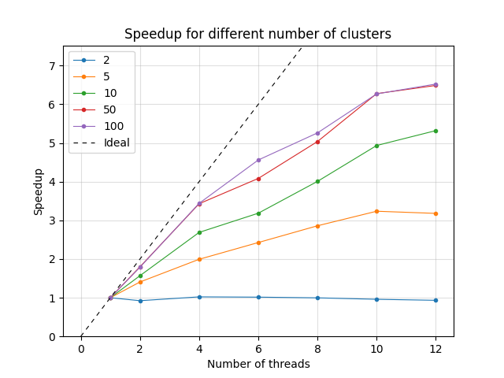
K-Means Clustering with OpenMP
Performance
Speed as the number of clusters changes:
 | 2 Threads | 4 Threads | 6 Threads | 8 Threads | 10 Threads | 12 Threads
2 | 0,92 | 1,02 | 1,02 | 1,00 | 0,96 | 0,93
5 | 1,41 | 1,99 | 2,43 | 2,86 | 3,24 | 3,18
10 | 1,57 | 2,69 | 3,18 | 4,01 | 4,93 | 5,32
50 | 4,80 | 3,43 | 4,08 | 5,04 | 6,28 | 6,49
100 | 1,79 | 3,44 | 4,56 | 5,26 | 6,27 | 6,52

Slide 24
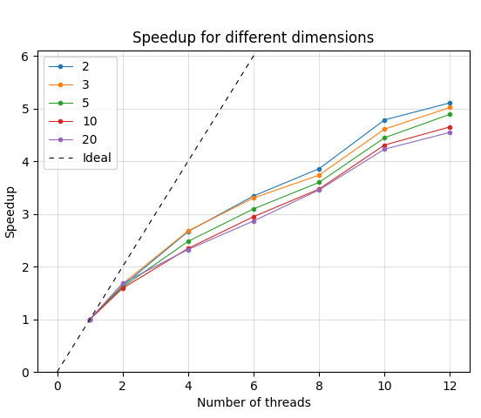
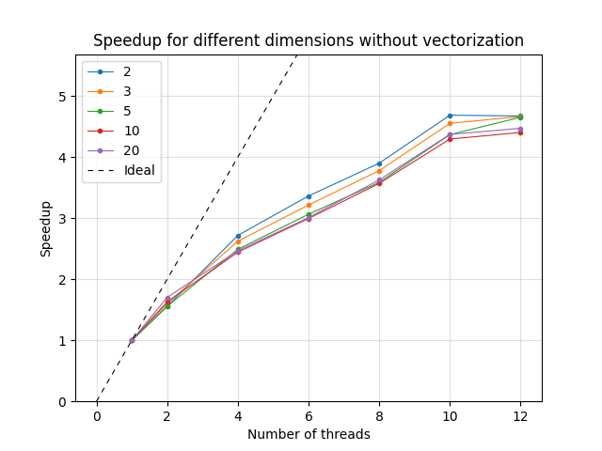
K-Means Clustering with OpenMP
Performance
Speed as the dimensions changes:
 | 2 Threads | 4 Threads | 6 Threads | 8 Threads | 10 Threads | 12 Threads
2 | 1,63 | 2,67 | 3,34 | 3,86 | 4,78 | 5,11
3 | 4,67 | 2,68 | 3,30 | 3,74 | 4,61 | 5,02
5 | 1,61 | 2,48 | 3,10 | 3,60 | 4,45 | 4,89
10 | 1,59 | 2,35 | 2,95 | 3,47 | 4,31 | 4,65
20 | 1,69 | 2,32 | 2,87 | 3,45 | 4,23 | 4,55

Slide 25
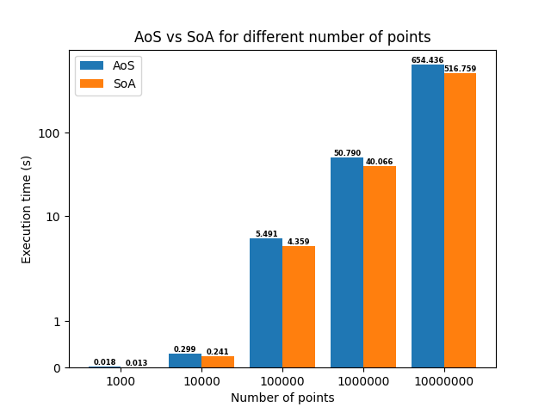
K-Means Clustering with OpenMP
Performance
AoS vs SoA:

Slide 26
K-Means Clustering with OpenMP
Performance
Conclusions
Parallel code results in higher performance than sequential code.
OpenMP parallelization is particularly advantageous with an increasing number of variables involved, enabling a significant improvement in speedup.
SoA architecture reduces the execution time.
Vectorization provides a slight improvement in high-dimensional computation.

